Slide 1
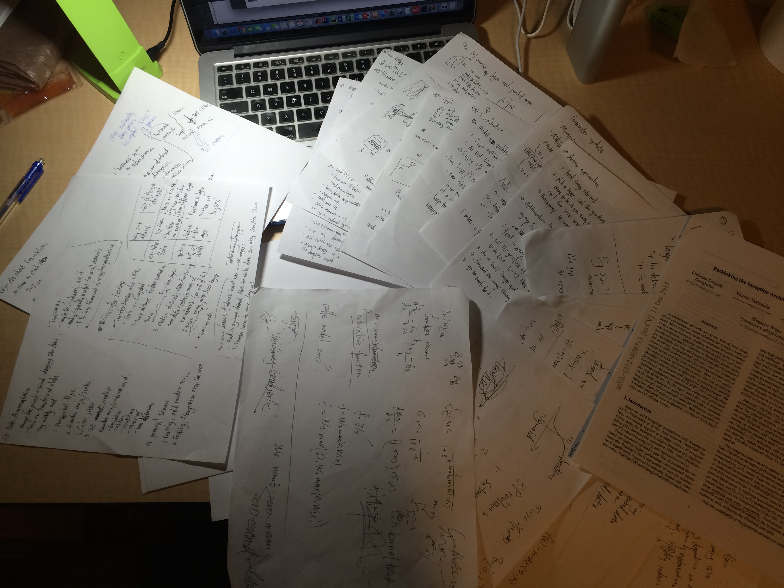
Summer Research
Yin Liu

Slide 2
I mainly worked on designing experiments to understand the generalization ability of deep neural networks with different architectures
Traditional Conv Net
ResNet
DenseNet

Slide 3
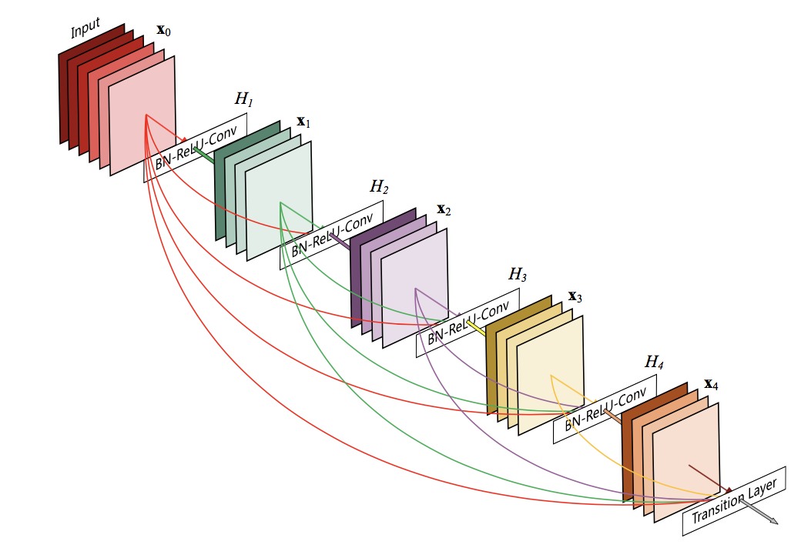
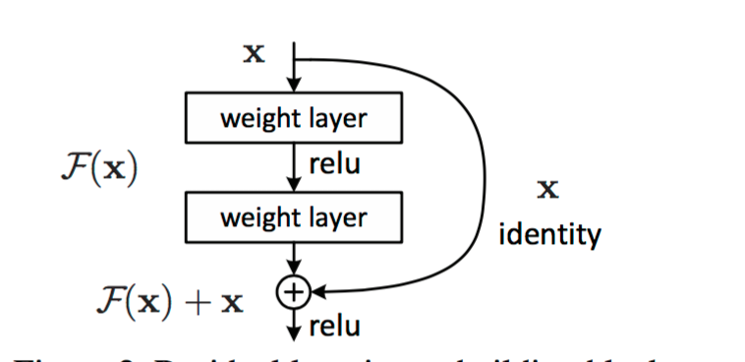
Traditional
ResNet
DenseNet

Slide 4
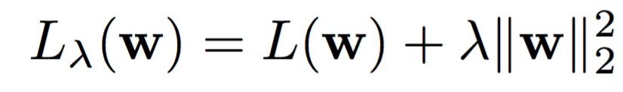
Weight Decay (to DenseNet)
Default mode: λ doesn’t vary throughout the whole net.
Cause
I think there may exist some differences between low-level features and high-level features.
Adjustment: make λ change gradually with depth of the same net
Experiment

Slide 5
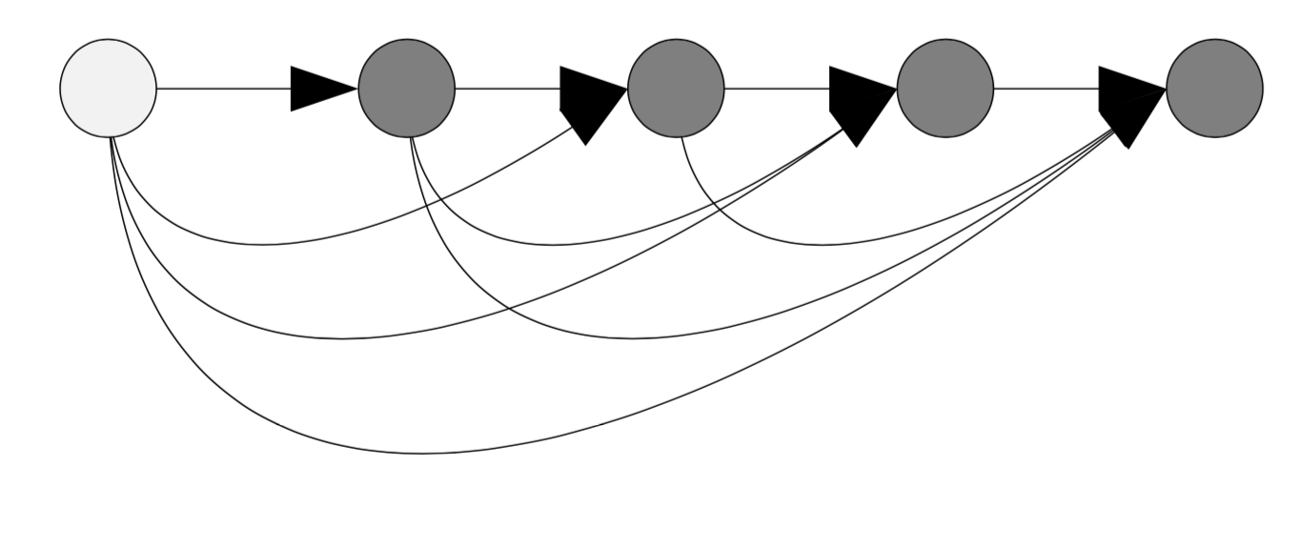
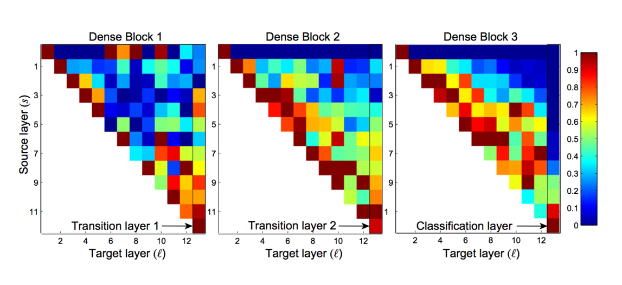
Weight Decay (to DenseNet)
Not an easy stuff:
What's the gradual form
Linear?
Exponential?
Which to base on?
Distance between two layers?
Position of source layer?
Which layers to modify?
Conv?
Batchnorm?
Other form?
Position of target layer?
I am still working on it…

Slide 6
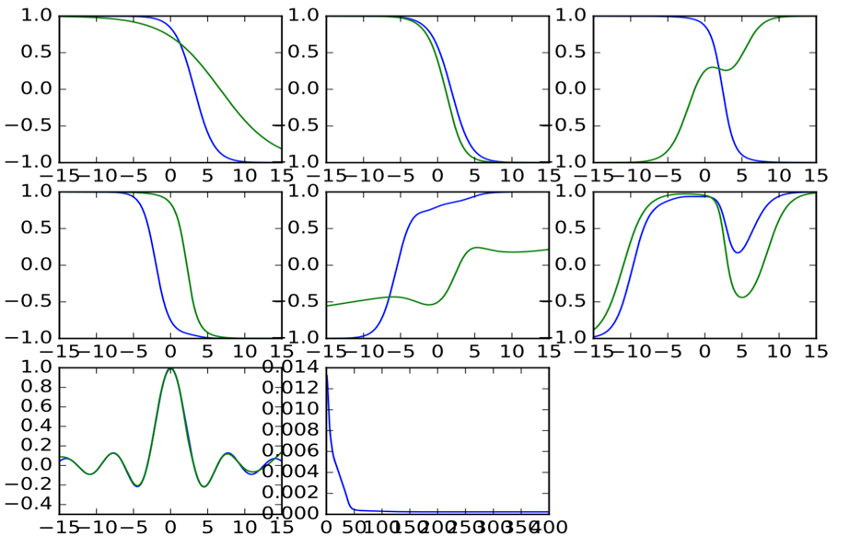
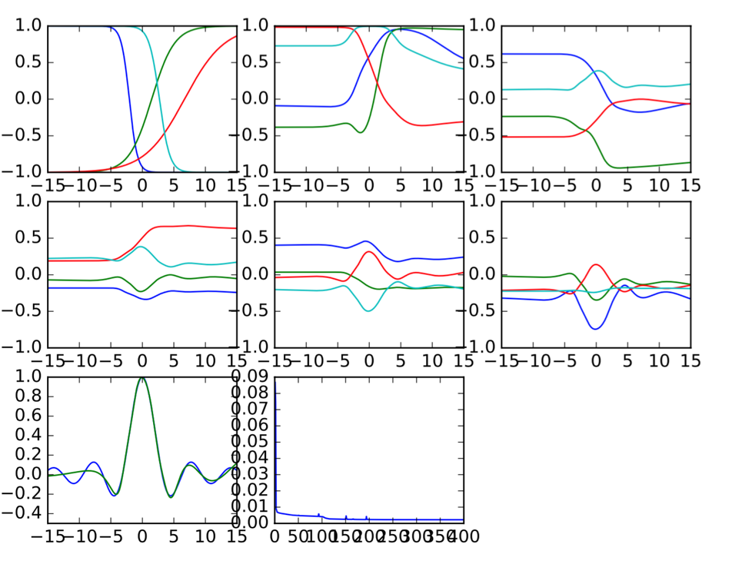
Curve Fitting
Dense
Plain

Slide 7
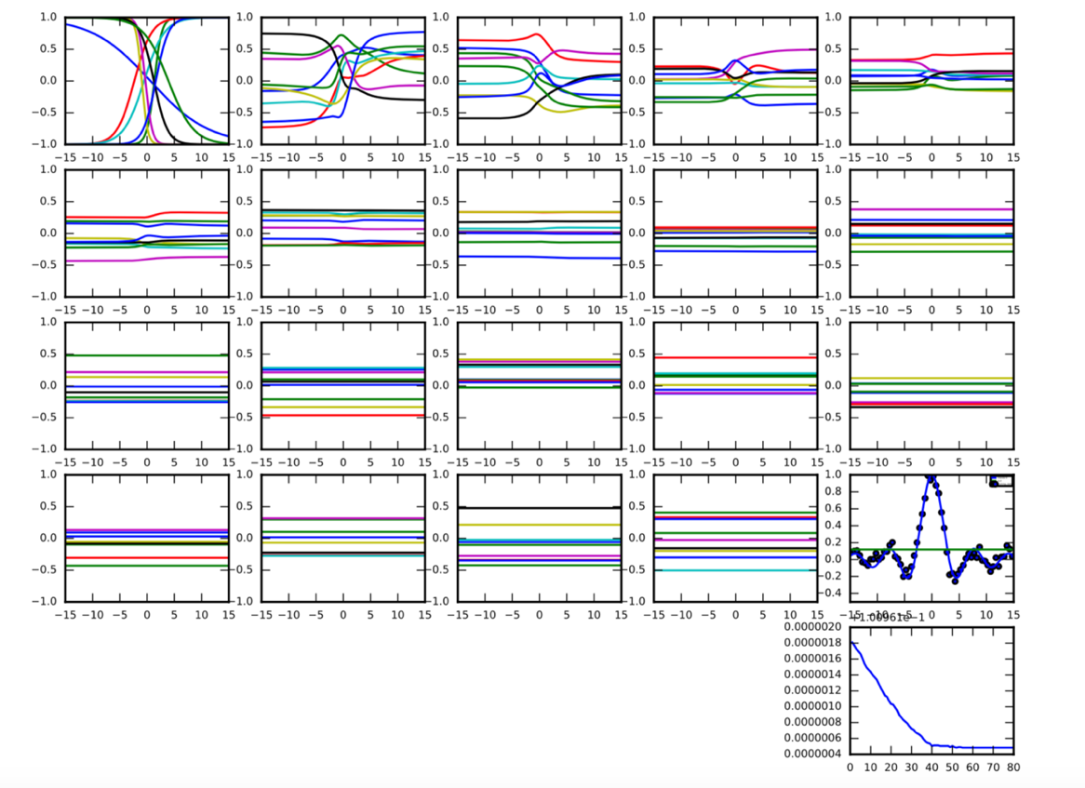
Curve Fitting
Traditional one
Worst,
vanishing gradient

Slide 8
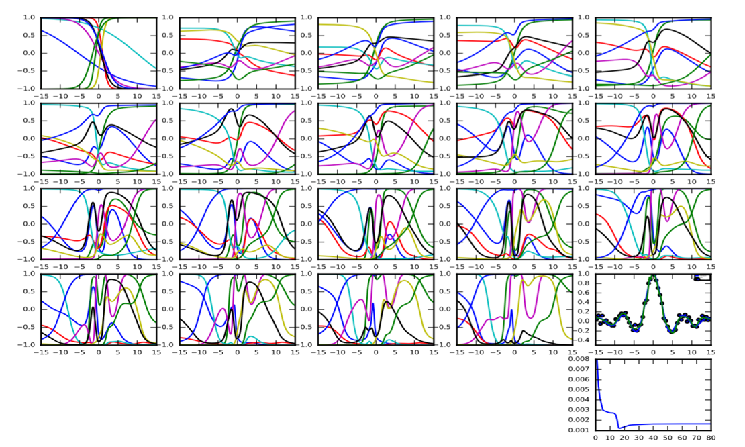
Curve Fitting
With Residual connection
Complicated and more accurate than traditional one

Slide 9
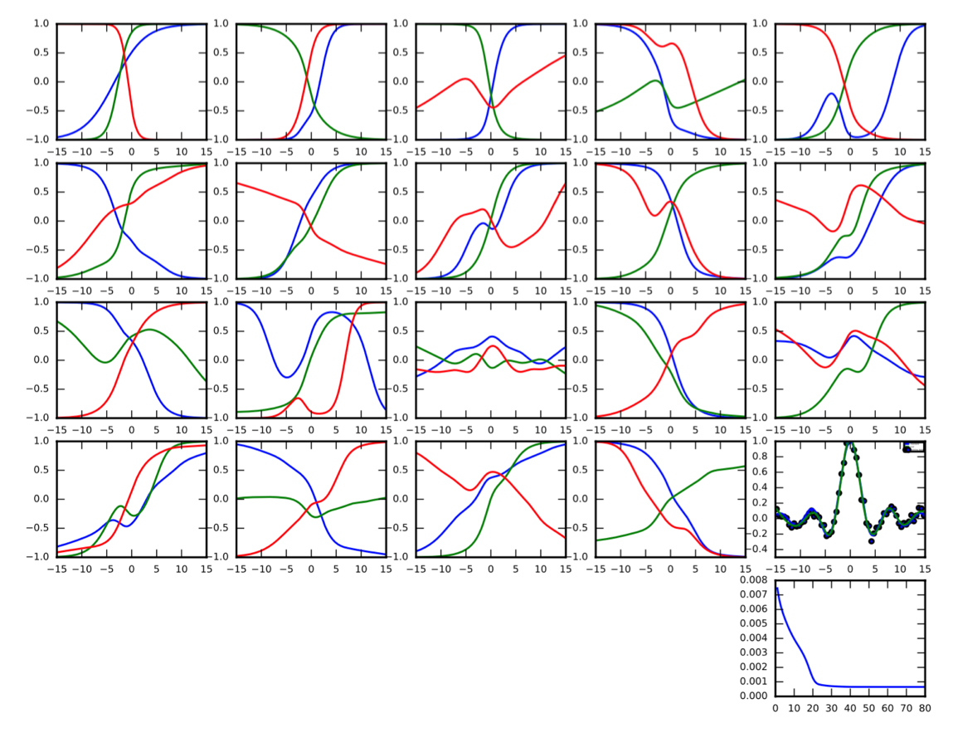
Curve Fitting
With dense connectios
Simple and accurate

Slide 10
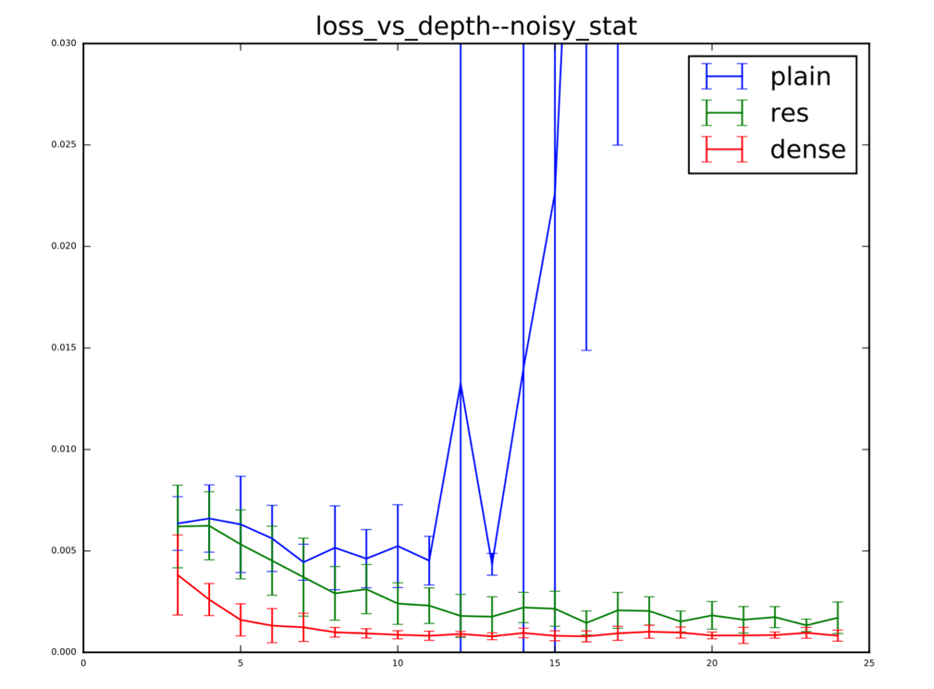
Curve Fitting
Results
Simple output from each layer.
Net with dense connection can do the regression best.
I think we can rethink about this interesting architecture and its tremendous learning power.

Slide 11
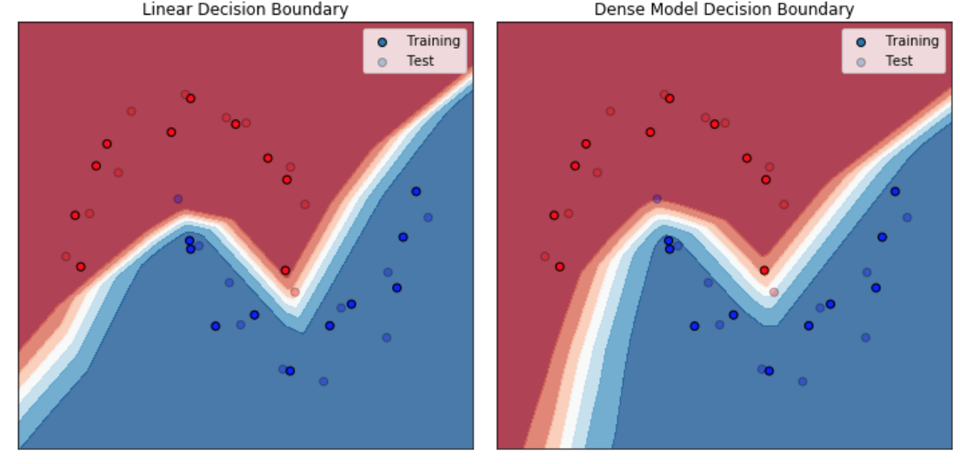
2-dimension decision boundary
My partner’s work

Slide 12
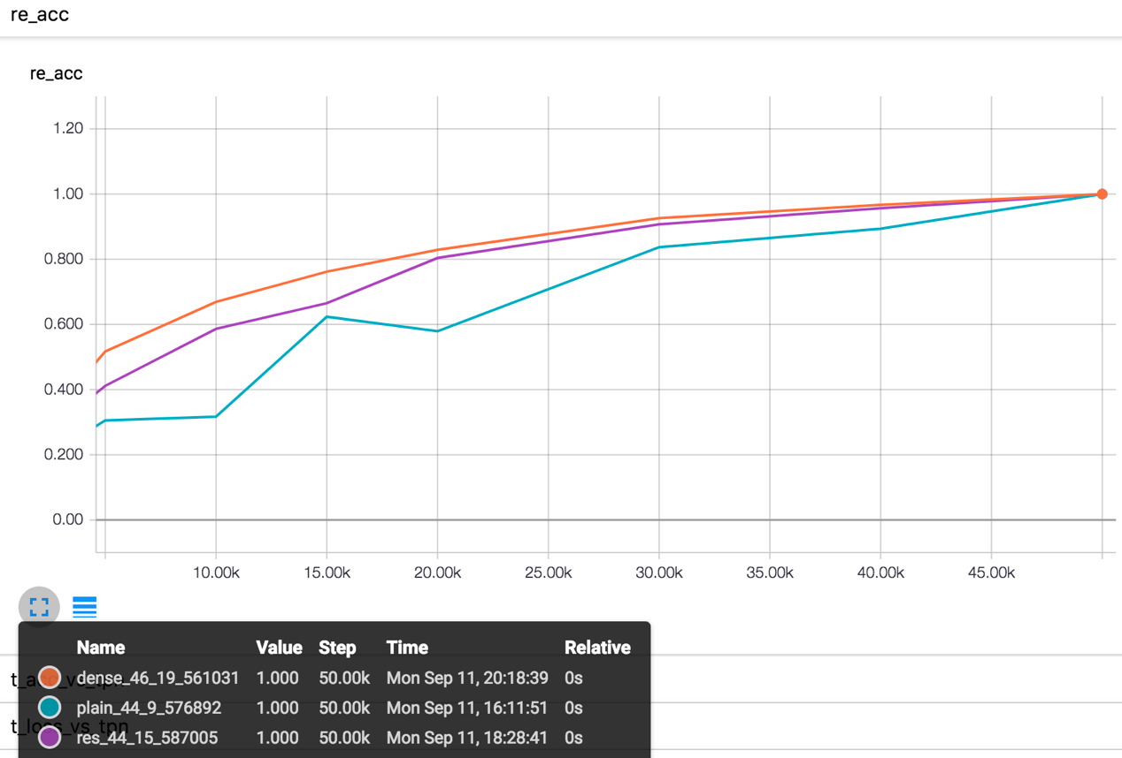
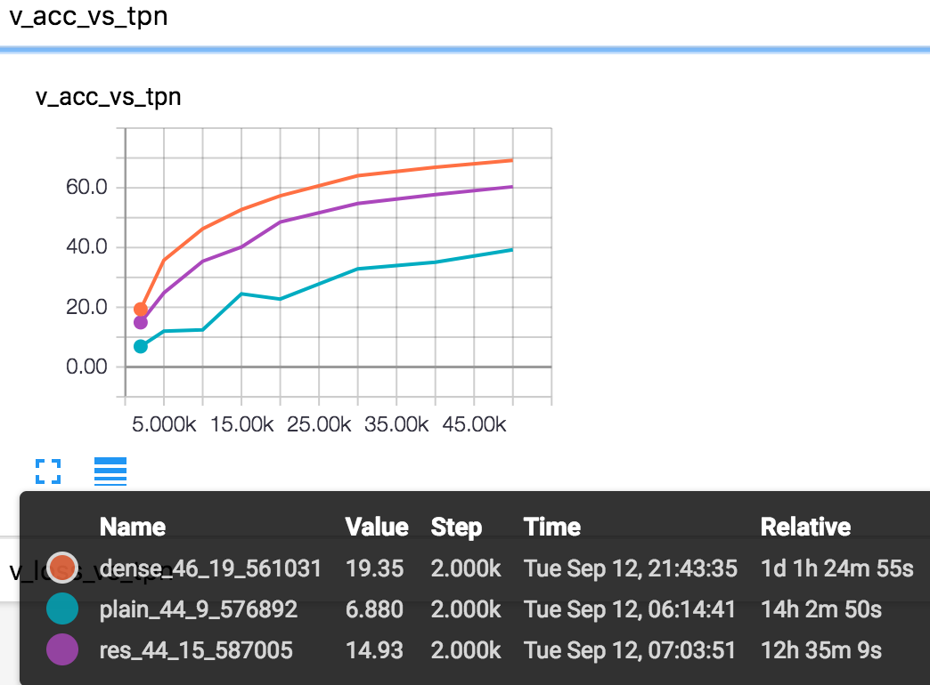
Findings when condition is bad
Insufficient training data
Absolute validation accuracy
Relative

Slide 13
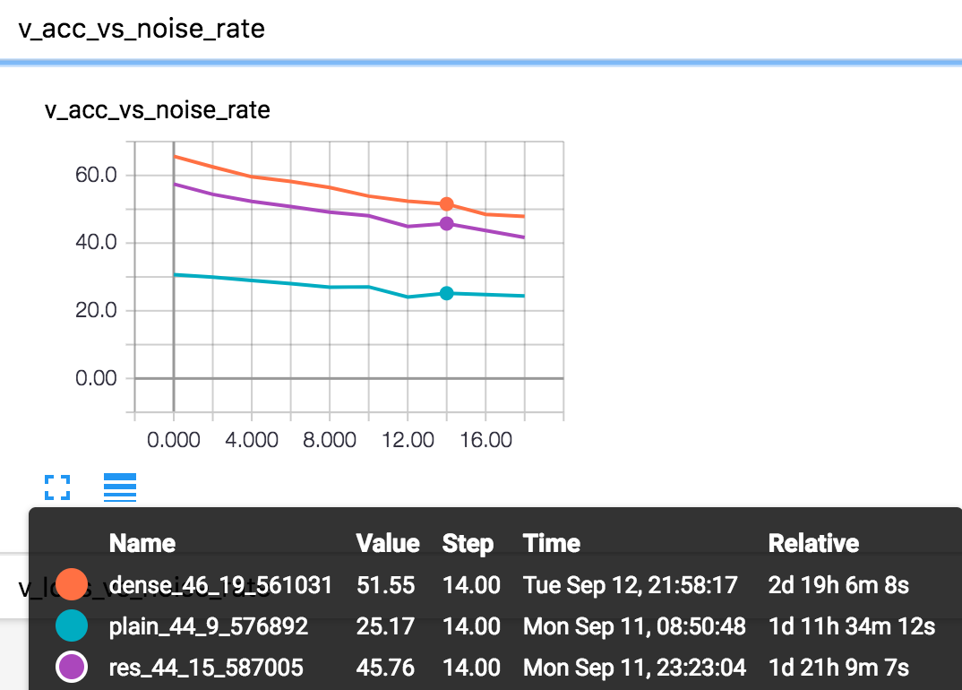
Findings when condition is bad
Noise
It is supposed to be like when doing relative comparison, the dense one will also be the best and the gap will exist with the increase of noise.

Slide 14
Thank you!

